Slide 1
Money: $10.000.000
Cost per Month : $10.000
Buildings
Vehicles
Rockets
Staff
Buy
Missions

Slide 2
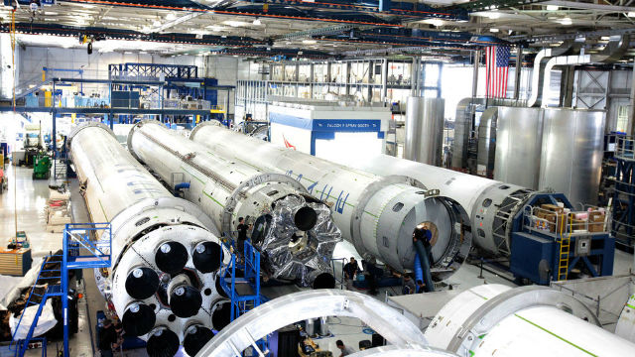
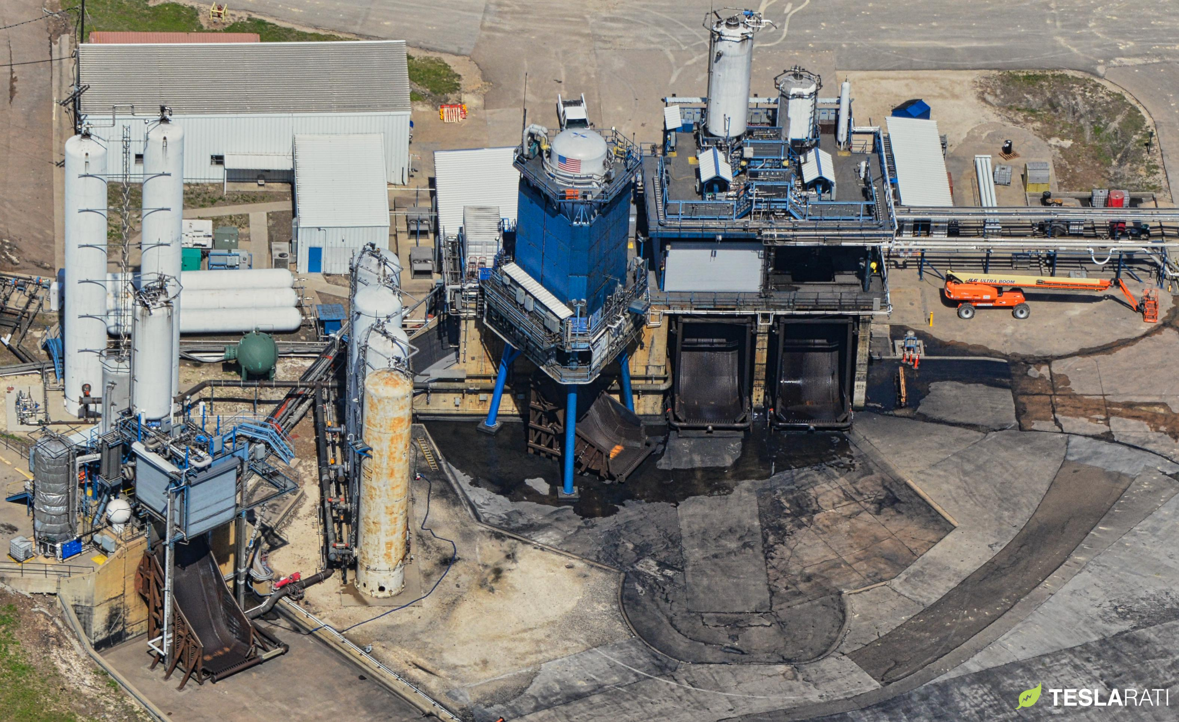
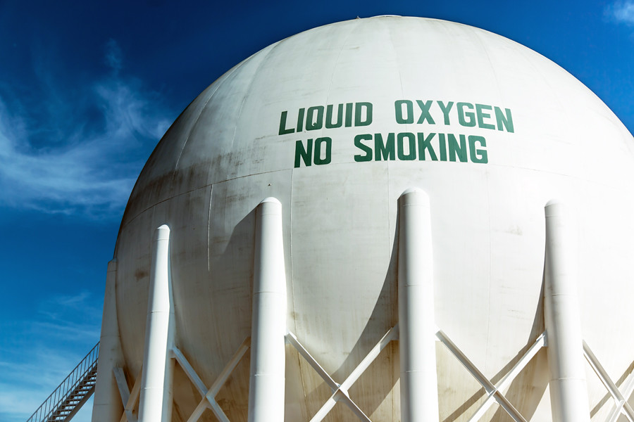
Money: $10.000.000
Cost per Month : $10.000
Buildings
Rocket Factory
$250.000.000
Rocket Test Lab
$50.000.000
Liquid Oxygen Plant
$5.000.000

Slide 3
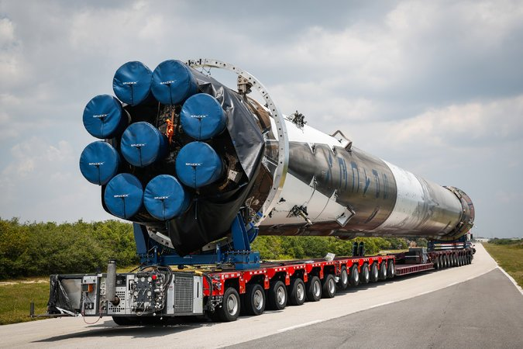
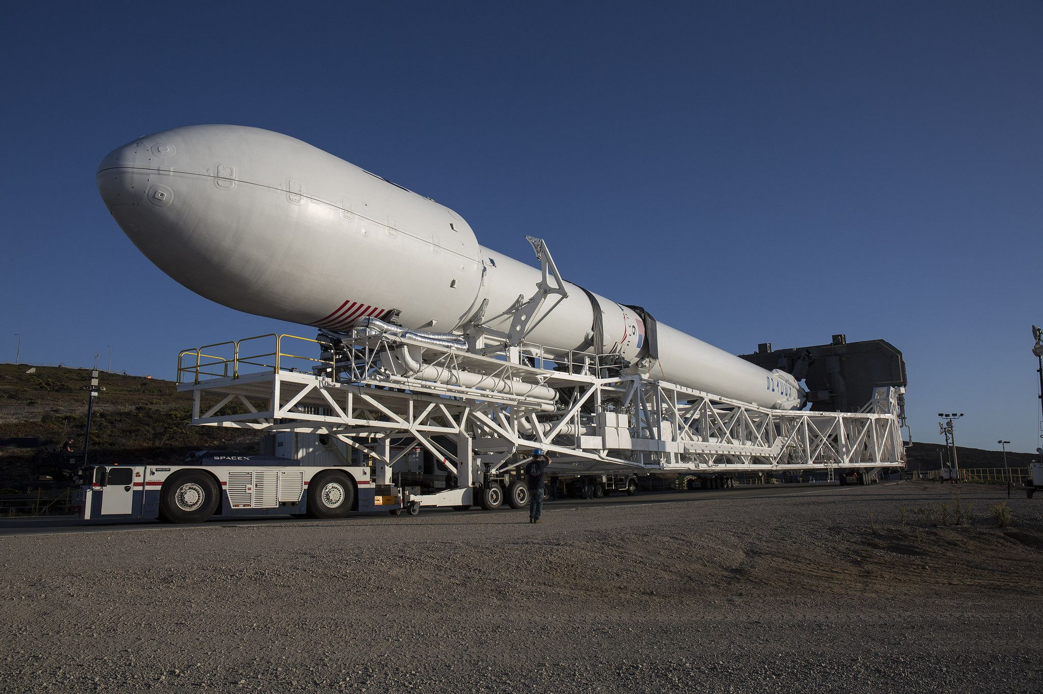
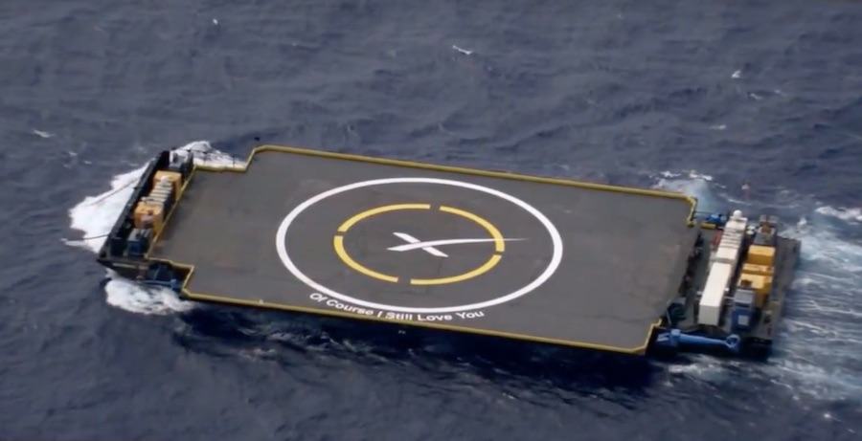
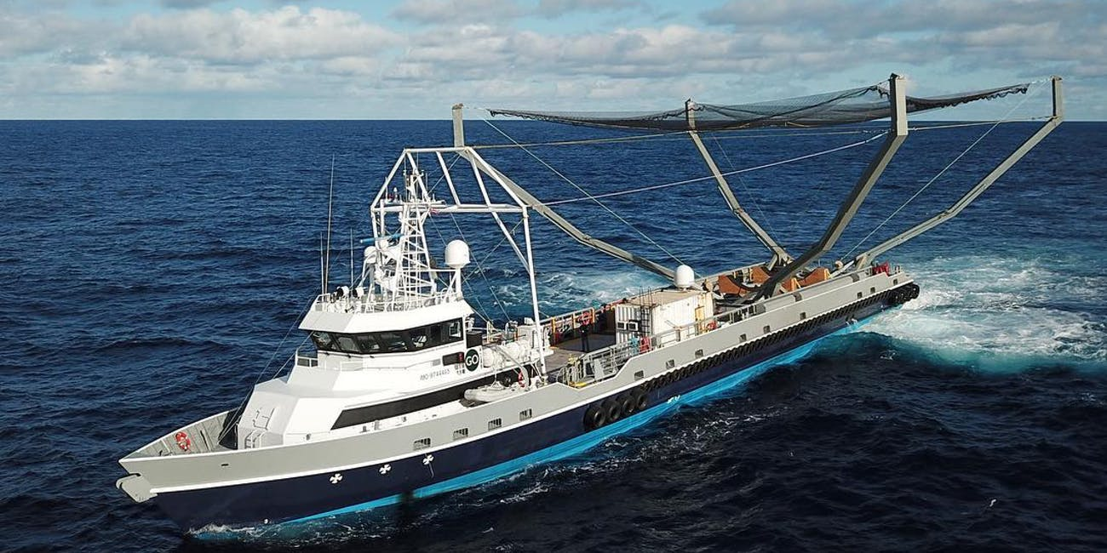
Money: $10.000.000
Cost per Month : $10.000
Vehicles
Launche Site
Transporter
$2.000.000
Transporter
$500.000
Drone Ship
$5.000.000
Fairing Ship
$3.000.000

Slide 4
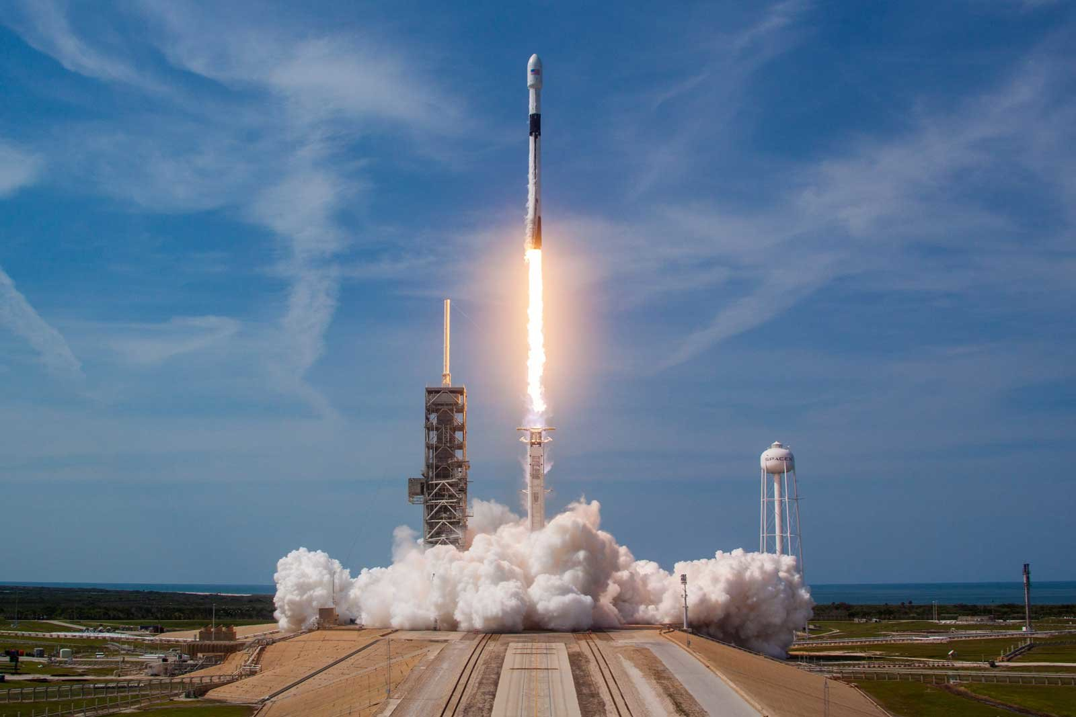
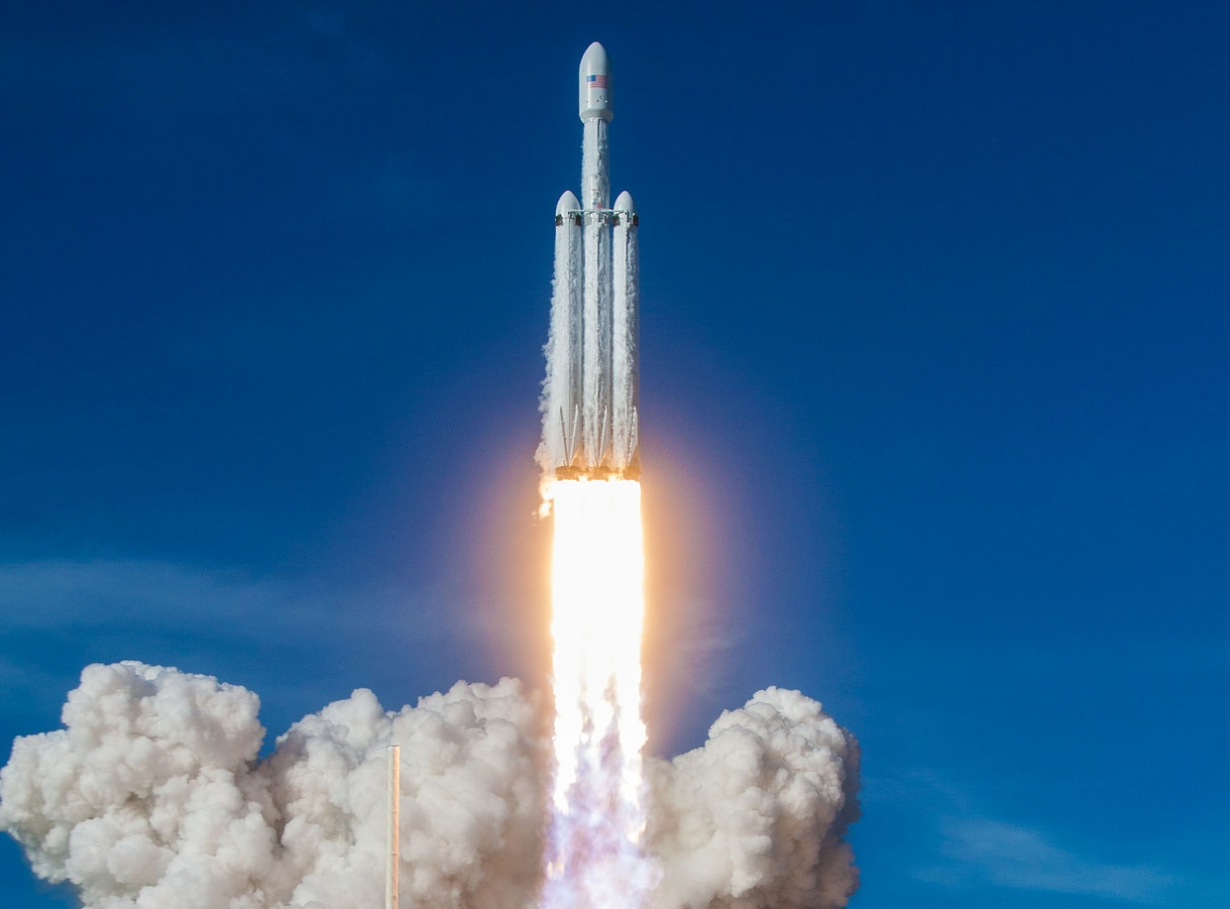
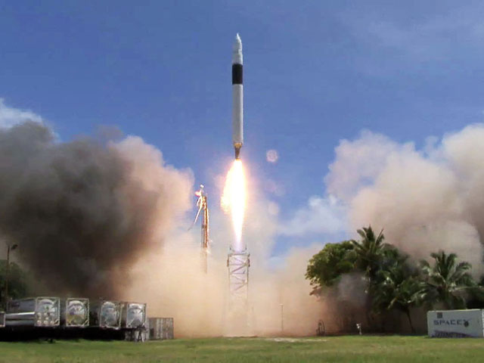
Money: $10.000.000
Cost per Month : $10.000
Rockets
Falcon 9
$50.000.000
Falcon 9 Heavy
$90.000.000
Falcon 1
$10.000.000

Slide 5

Money: $10.000.000
Cost per Month : $10.000
Staff
Director
$25.000
per month

Slide 6

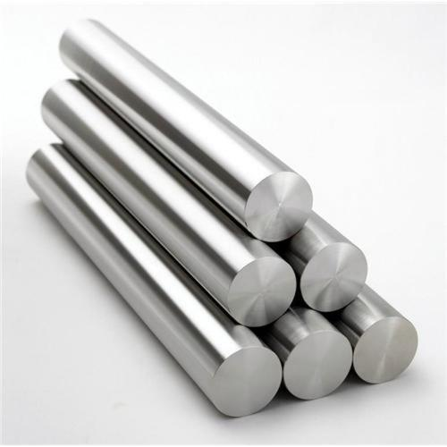
Money: $10.000.000
Cost per Month : $10.000
Buy
Buy Iron
$1000 per ton
Buy Titanium
$50.000 per ton
Market place
Buy stuff form other
players

Slide 7
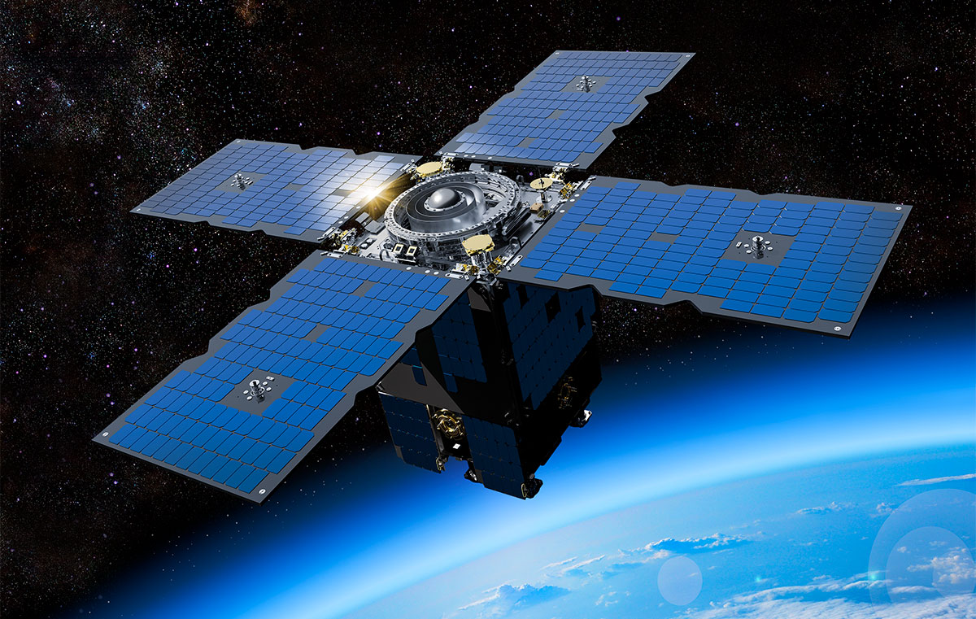
Money: $10.000.000
Cost per Month : $10.000
Mission
Launch
SatCom 1
$10.000.000

Slide 8
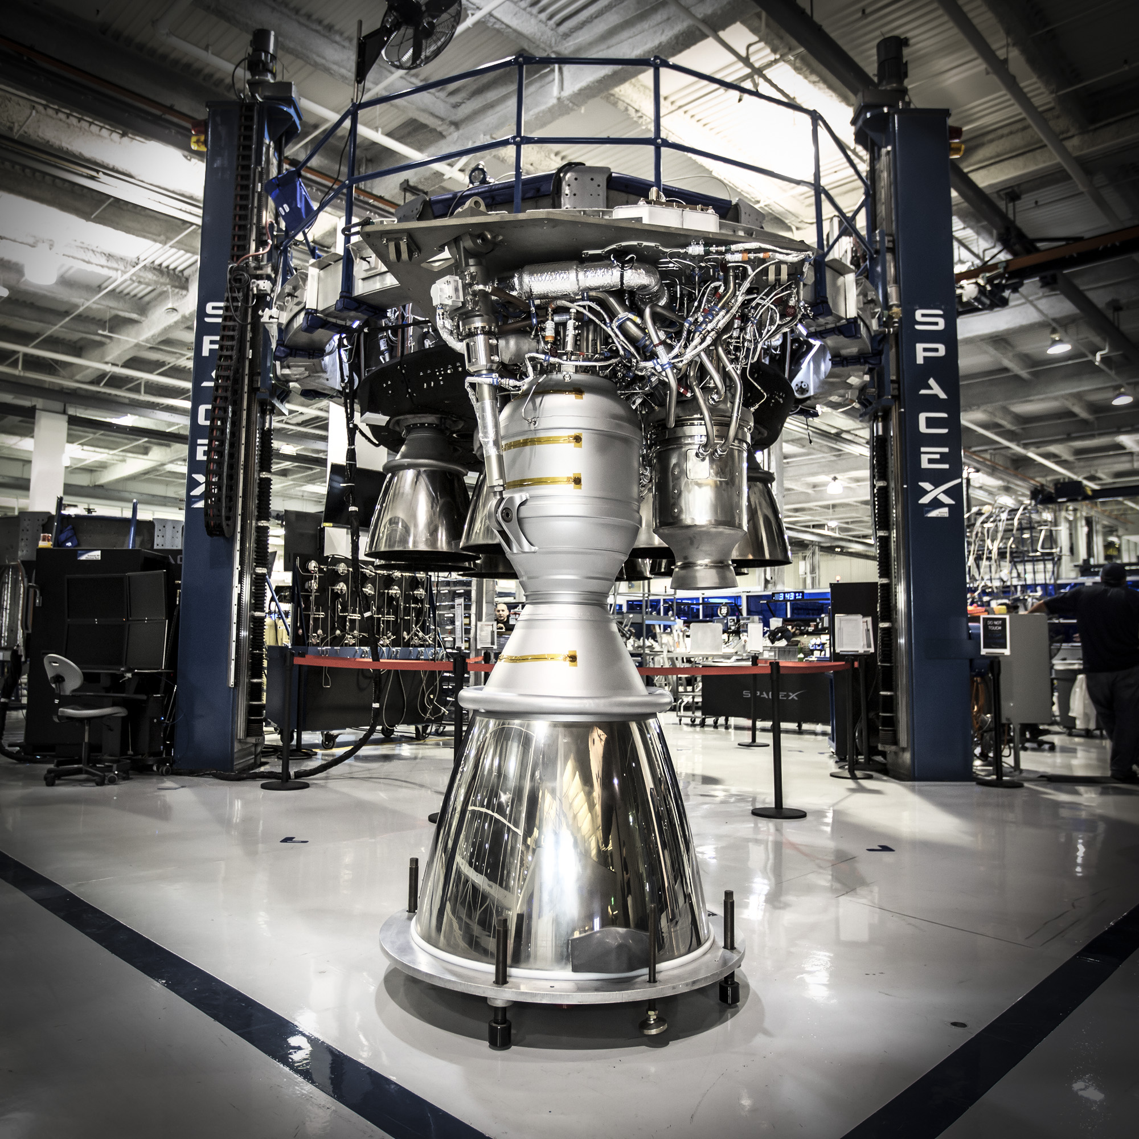
Production [1/2]
10 ton
Iron
Production Cost $10.000
Time: 10 hours
1
Engine
Produce
Rocket Engine
5 ton
Titanium

Slide 9
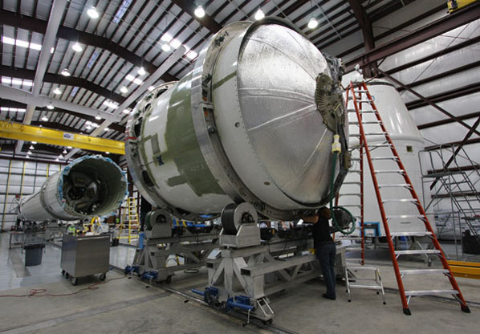
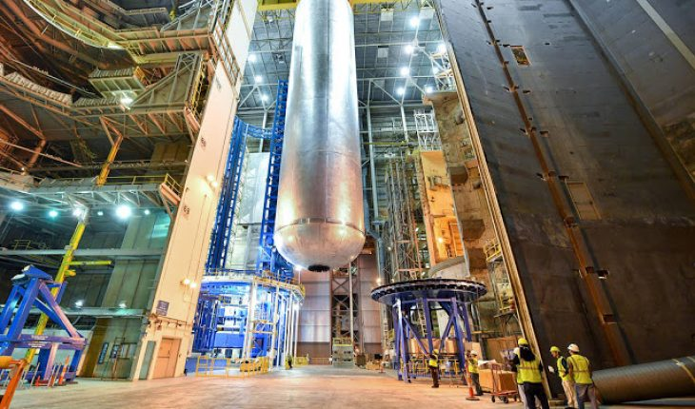
Production [2/2]
9
Engines
Production Cost $5.000.000
Time: 30 days
1
Oxygen tank
1
Falcon 9
Produce
Falcon 9
1
Fuel tank

